Slide 1


ChartLight
Diego Garcia, Omar Bane
University of Advancing Technology
Network Engineering Cyber security, SIP311

Slide 2

Technical Expertise & Background
This product will be in line with some network engineering practices as it falls in line with windows group management best practice, and the Windows OS itself. This also falls in line with cyber security by reflecting the popular policy of least access which will minimize human error.
Diego Garcia
Skills are focused on Security and Engineering which include: documentation, Risk mitigation, Log management, Windows Active directory.
Omar Bane
Skills are focused on Computer System Engineering: Embedded system testing, Risk mitigation, Log management, linux.
Notes:
Guidelines: Refer to the Tech Resources document provided by your SIP Instructor

Slide 3

Problem Statement
Many security risks stem from user distraction. These risks cause changes on a device which open up your system to financial losses , and a loss off your time. In an office encouraging a individual to focus helps mitigate these risks and improve your product results. Simultaneously workplace efficiency and productivity helps with workplace and project atmosphere. ChartLight Works to combat these issues.
Notes:
Guidelines:

Slide 4
Project Description & Scope
The project will first be focused on UI, having a good overlay which allows for a minimized window to be on screen. The screen will be prioritized as the project’s first milestone, afterwards bells and whistles such as timers for different levels of access which can be enabled or disabled will be implemented as a second milestone. In addition, the second milestone will likely contain some level of log tracking as a secondary priority. Lastly the third milestone will be to make the application accessible remotely for Admin accounts to be able to manage the application and their users. The third milestone will have logs as apart of its management.
The PM system I will be using will reflect Production Studio’s time spreadsheet and Trello combination. Figma is also being considered.
Notes:
PM: Project Management

Slide 5
Innovation Claim
ChartLight will allow for safer User experience and provide streamlined office task management. It will do this through reducing user interaction with unnecessary parts of the screen, reducing the amount of human error. A main error being the potential for distraction. The product will limit the amounts of applications which can be opened and/or keep logs of them as the administrator sees fit.
This can be commercialized for office settings, school projects, be used personally, or as a parent.

Slide 6
Target Market
Directions:
This product is intended for group projects. Whether for students ages 15 or older or the administrators of said projects this tool is recommended. As a project time management tool it is also intended for those who may struggle with attention deficits such as those with ADHD.
Considering these demographics I would be interested in implementing this in large work areas such as UAT’s commons, or SOC as a test ground and potential .

Slide 7

Prior art
Concept art collage:
Used for
Target demographic
Logos
Fonts
themes
colors

Slide 8
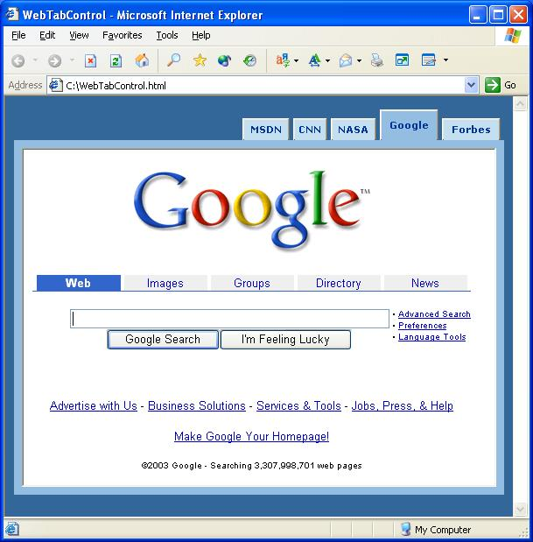
Early-State Product/Prototype
LOCKED
Timers: XX:XX
Tasklist Task 1 Task 2 Task 3
Notes:
Note: add more slides as needed

Slide 9
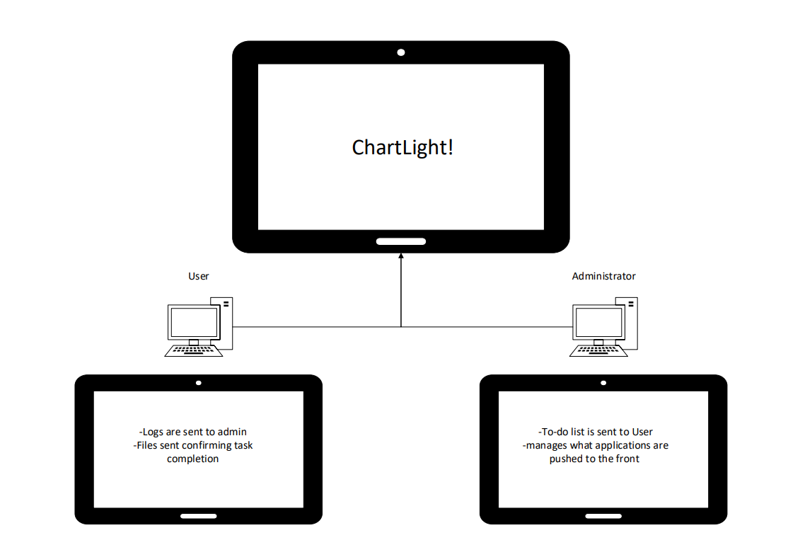
Flowchart

Slide 10
Q&A
Diego Garcia: Network Engineering, Cyber Security
diegarci@uat.edu, Discord: diegogarcia04
Omar Bane: Computer science, Computer System Engineering
eobane@asu.edu, Discord: bebluetea
Innovation Claim: ChartLight will allow users and admin to have applications pushed towards their focus, minimizing security risks in the process, and documenting application use as needed.

